Slide 1
Babies, toddlers and languages (start early, learn language/s)
Keith Kelly

Slide 2
Brain activity differences in mono- and bilingual babies
University of Washington
16 babies tested (8 mono-, 8 bilingual families) Sounds from both Spanish and English language
Magnetoencephalography (MEG)
prefrontal cortex + orbitofrontal cortex activity
= executive functions
= better decision making, higher-order problem solving, memory, focus switching skills = key to success in schooling, happiness, and avoiding dementia-related illnesses in later life

Slide 3
Conclusions and advice
“Our results underscore the notion that not only are very young children capable of learning multiple languages, but that early childhood is the optimum time for them to begin”
Start early, even if you’re not a bilingual family. Create routines in both languages and stick to them (storytime, bathtime, mealtimes etc)
https://bit.ly/36ZWRqD

Slide 4
Bilingual Brain Wiring
Babies are wired to process more than one language
NB – being bilingual does not simply mean fluency in two languages!
Babies ‘hear’ around 26 weeks and separate languages We’re born able to hear and pronounce all the world’s sounds (600 consonants, 200 vowels) – but use it or lose it!
By 9 months, babies are starting to sort out the rules for themselves AND they match languages to people too.

Slide 5
Conclusions and advice
“Talking with your baby a lot in your languages gives them the opportunities they need to work out the patterns of the languages.”
Read with them, sing with them, play with them, talk with them in other languages.
https://bit.ly/36X7WbW

Slide 6
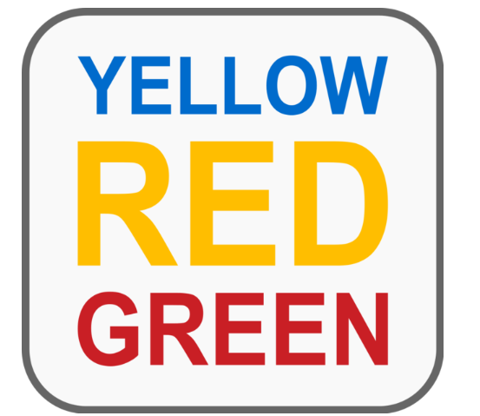
Benefits of bilingualism
Bilinguals have better:
control mechanisms
conflict management
inhibitory control (stroop tasks) + task switching
Bilingualism changes neurological structures and processing = better executive functions

Slide 7
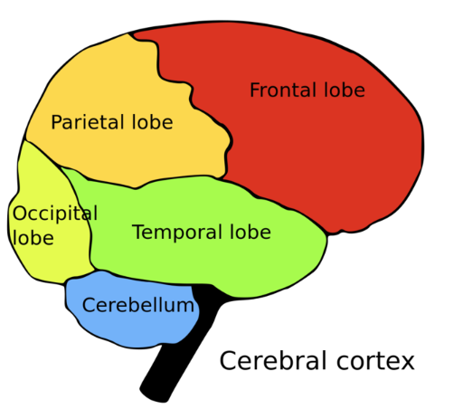
Bilingualism (early experiences of languages)
More grey matter in the parietal lobe responsible for language switching
Bilingualism leads to better information processing
Bilingualism gives more ‘cognitive reserve’ = later onset of brain diseases

Slide 8
Conclusions and advice
“To summarise, the cognitive and neurological benefits of bilingualism extend from early childhood to old age as the brain more efficiently processes information and staves off cognitive decline.”
Even if you leave it later, starting a foreign language in later years has been shown to have similar benefits for keeping dementia at bay in older people.
https://bit.ly/2GUWQJN

